Slide 1
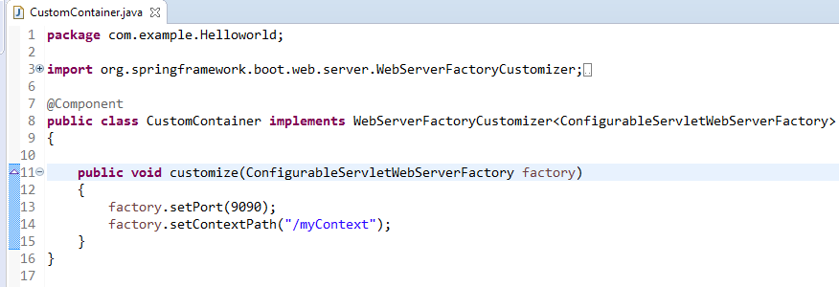
Spring Boot – How to Change Default Context Path Programmatically? 0r
Container Configuration in Spring Boot 2
We can change embedded servlet container default settings registering a bean that implements WebServerFactoryCustomizer interface. We need to override its customize() method.

